Slide 1
Systems Analysis and Design
5th Edition
Chapter 3. Requirements Determination
Dr. Esraa Ahmed
3-<number>

Slide 2
Chapter 3 Outline
The analysis phase.
Requirement determination.
Requirement elicitation techniques.
Requirement analysis strategies.
3-<number>

Slide 3
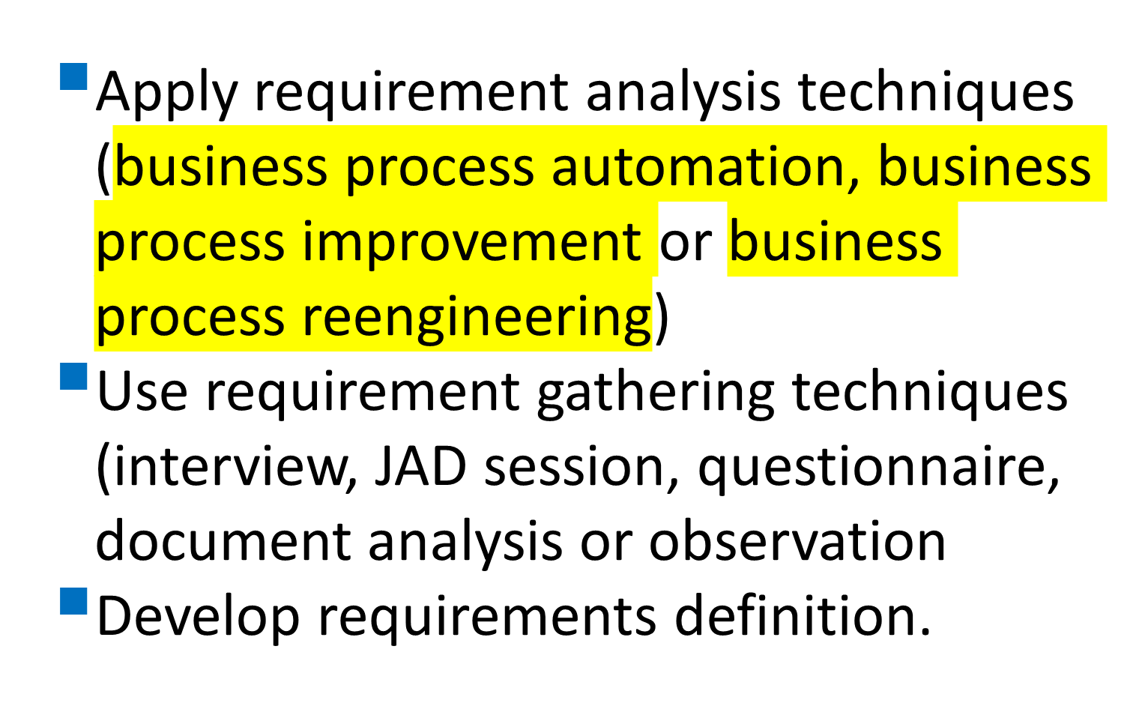
Analysis
3-<number>

Slide 4
THE ANALYSIS PHASE
Analysis refers to breaking a whole into its parts with the intent of understanding the parts’ nature, functions, and interrelationships.
The planning phase deliverables are the key inputs into the analysis phase.
Planning
Analysis
3-<number>

Slide 5
(cont’d)
The basic process of analysis involves three steps:
Understand the existing situation (the as-is system)
Identify improvements
Define the requirement for the new system (the to-be system).
3-<number>

Slide 6
(cont’d)
The final deliverables of the analysis phase is the system proposal.
The system proposal is presented to the approval committee in the form of a system walk-through to explain the system in moderate detail.
The deliverables from the analysis phase are the first step in the design of the new system.
3-<number>

Slide 7
REQUIREMENTS DETERMINATION
Requirements determination is performed to transform the system request’s high-level statement of business requirements into a more detailed, precise list of what the new system must do to provide the needed value to the business
3-<number>

Slide 8
What is a Requirement?
A requirement is a statement of what the system must do or what characteristics it needs to have.
Requirements describe
what the business needs
(business requirements)
what the users need to do (user requirements)
what the software should do
(functional requirements)
characteristics the system should have
(non-functional requirements), and
how the system should be built
(system requirements)
© Copyright 2011 John Wiley & Sons, Inc.
3-<number>

Slide 9
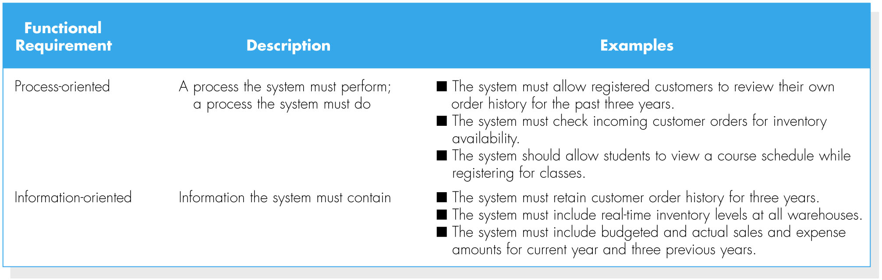
(cont’d)
Functional requirements
3-<number>

Slide 10
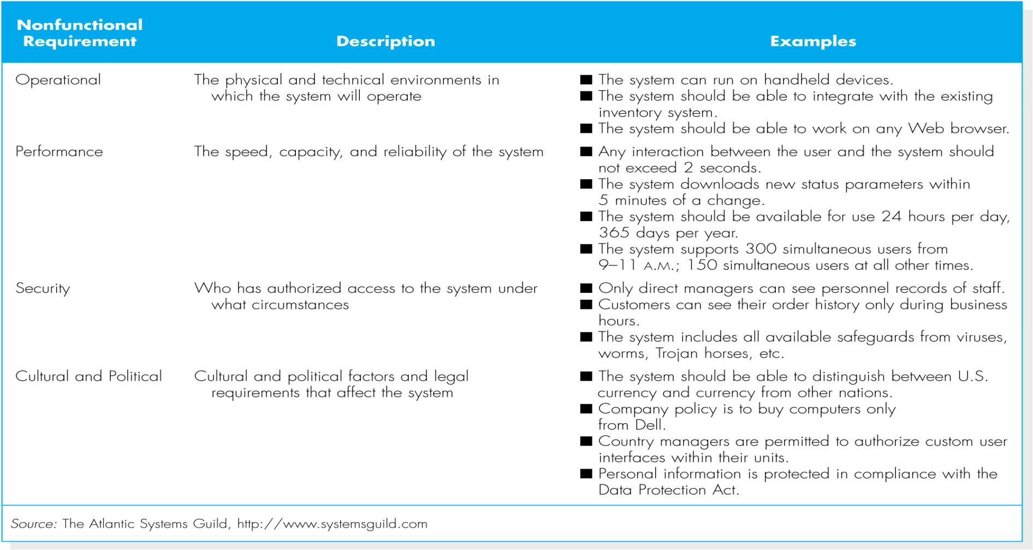
(cont’d)
Non-functional requirements
3-<number>

Slide 11
The Process of Determining Requirements
Both business and IT perspectives are needed to determine requirements during the analysis phase.
The most effective approach is to have both businesspeople and analysts working together to determine requirements.
The analyst must also consider how best to elicit the requirements from the stakeholders.
The process of determining requirements continues throughout the analysis phase, and the requirements definition evolves over time.
3-<number>

Slide 12
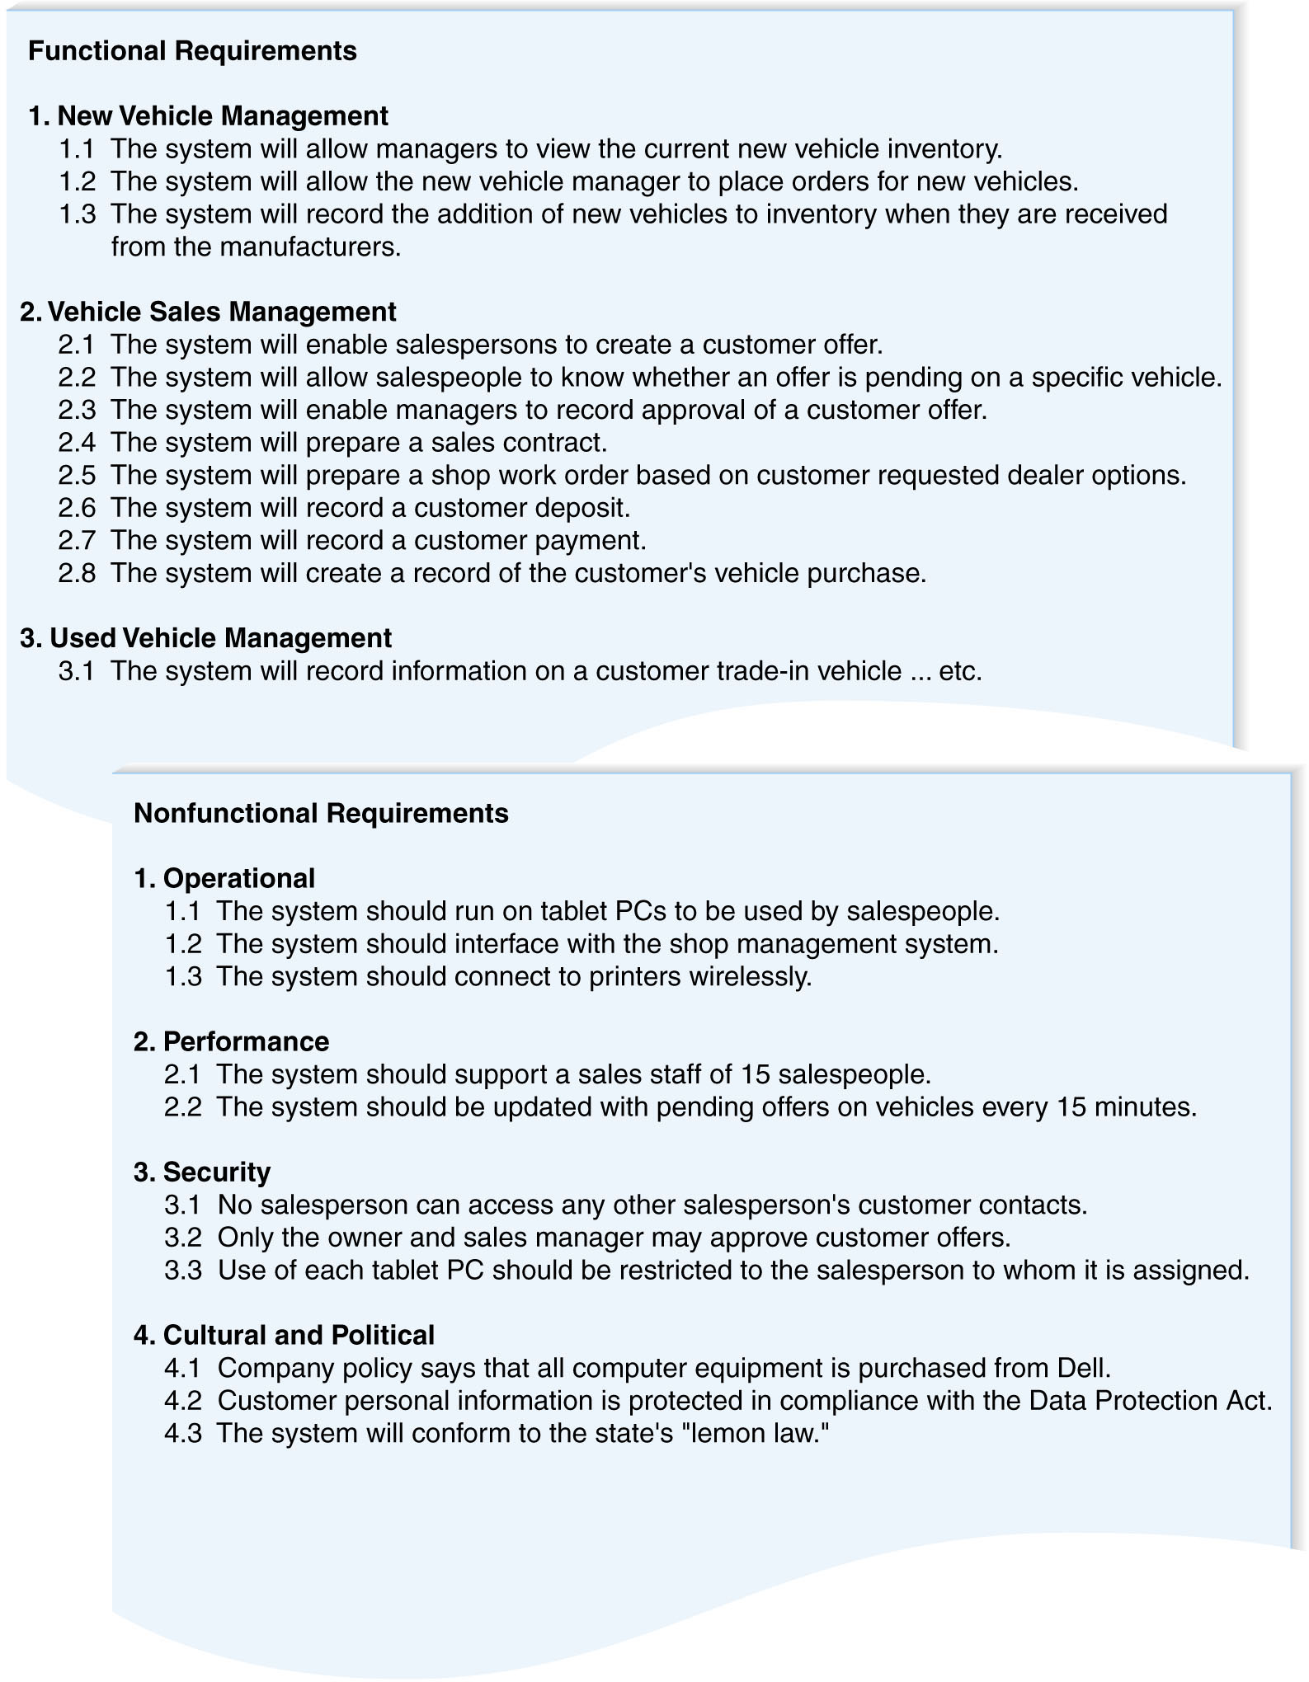
The Requirements Definition Statement
3-<number>

Slide 13
REQUIREMENTS ELICITATION TECHNIQUES
Requirements Elicitation in Practice
The analyst should recognize that important side effects of the process of determining requirements include 1-building political support for the project and 2-establishing trust between the project team and the users.
The analyst should carefully determine who is included in the process of determining requirements.
3-<number>

Slide 14
Interviews
The most commonly used requirements elicitation technique
Basic steps:
  Selecting Interviewees
  Designing Interview Questions
  Preparing for the Interview
  Conducting the Interview
  Post-Interview Follow-up
3-<number>

Slide 15
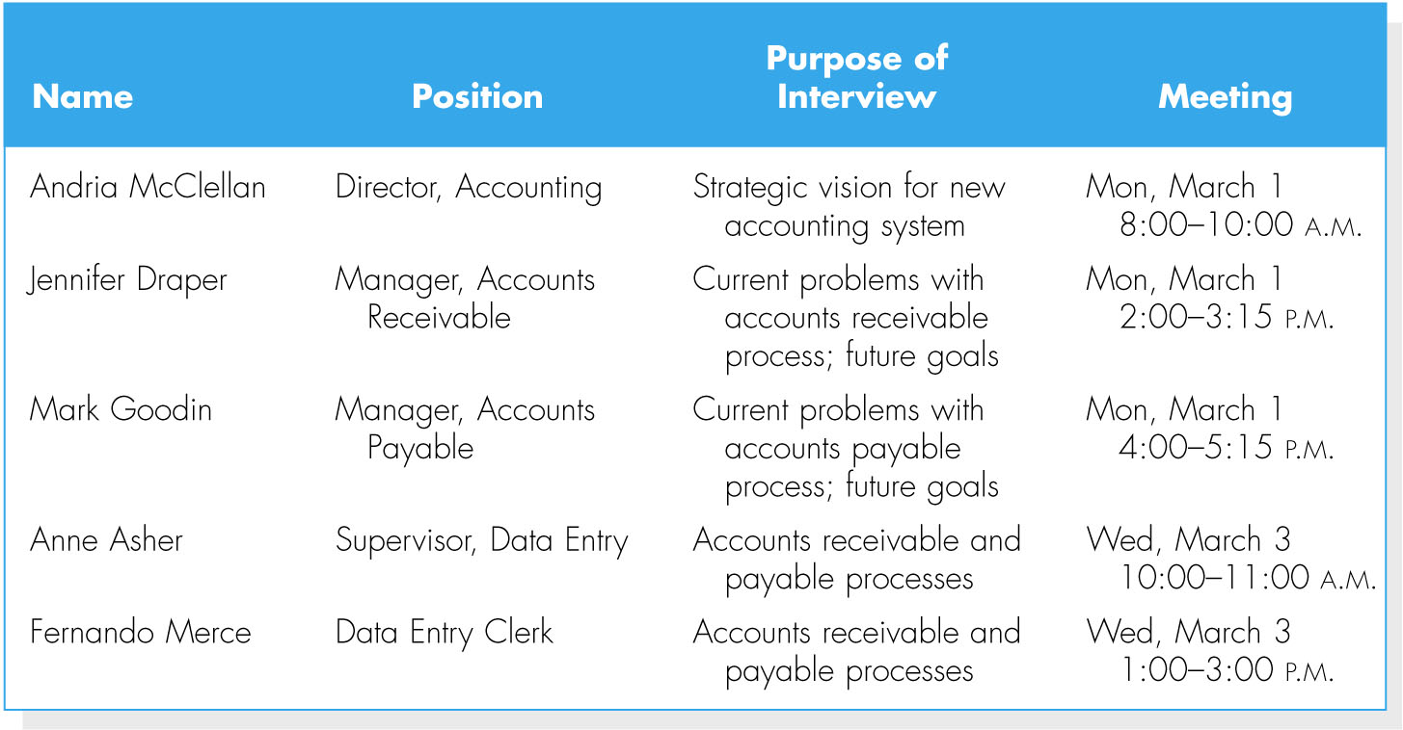
Selecting interviewees
Interview schedule
Including people at different levels of the organization
  Managers
  Users
  Other key stakeholders
3-<number>

Slide 16
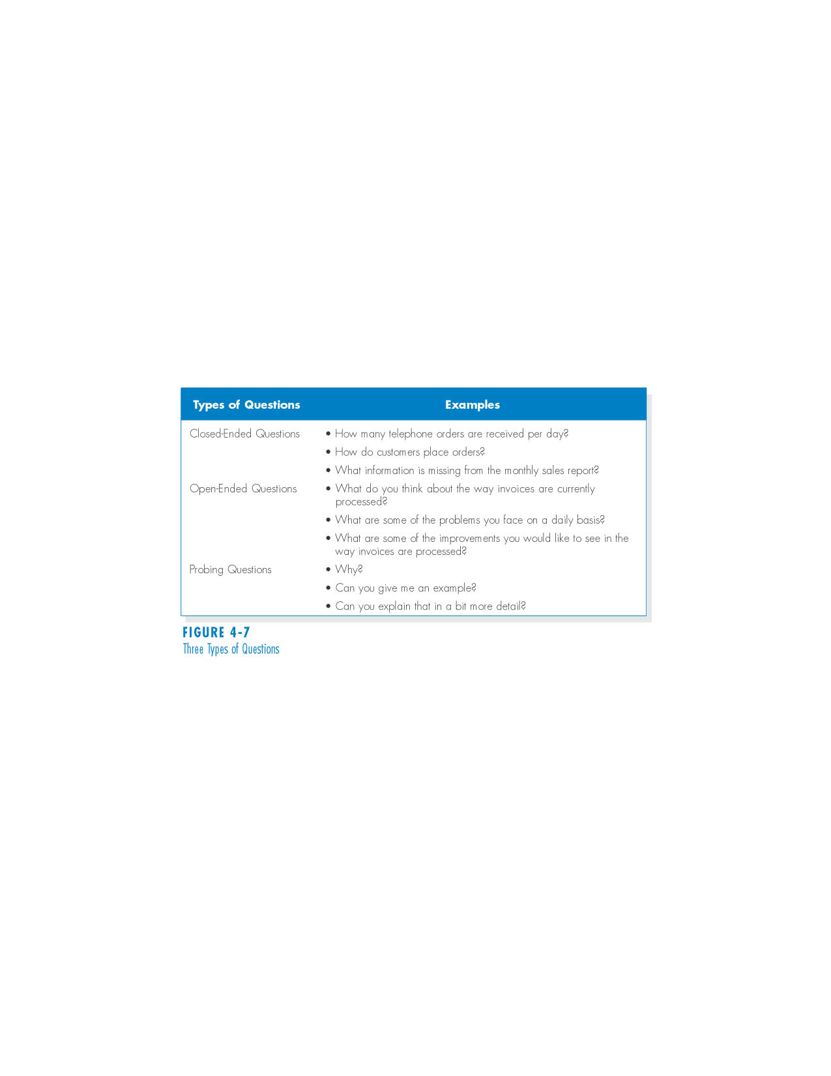
Designing interview questions
3-<number>

Slide 17
(cont’d)
Unstructured interview
  for a broad and roughly defined set of information
Structured interview
  for very specific information
3-<number>

Slide 18
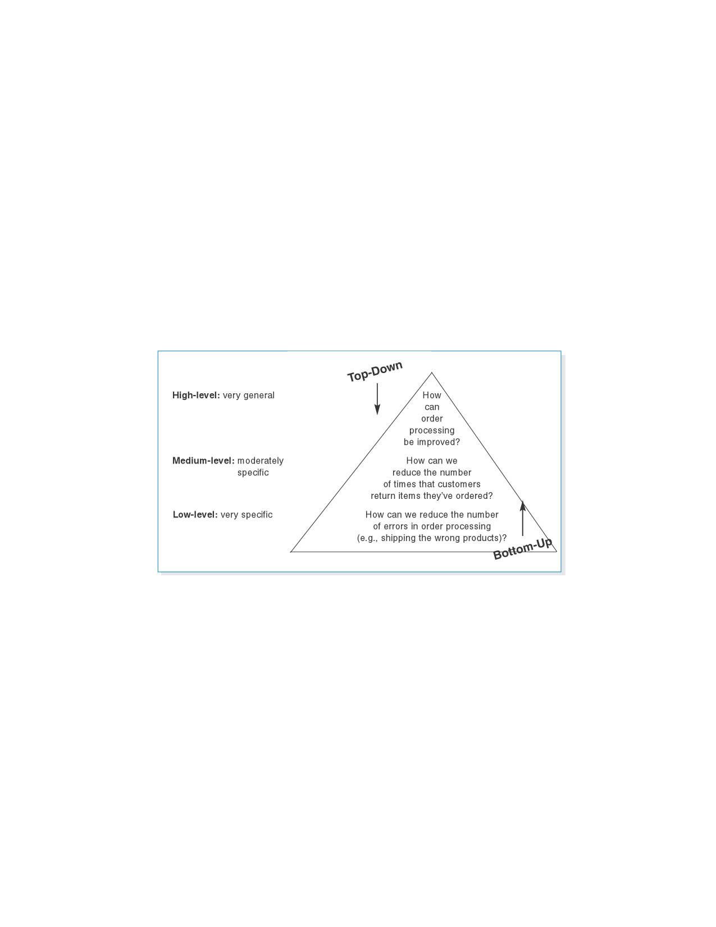
(cont’d)
Top-down vs. bottom-up interview
3-<number>

Slide 19
Preparing for the interview
Prepare a general interview plan
Confirm areas of knowledge
Set priorities in case of time shortage
Prepare the interviewee
  Schedule
  Inform of reason for interview
  Inform of areas of discussion
3-<number>

Slide 20
Conducting the interview
Appear to be professional and unbiased.
Record all information.
Be sure you understand the issues that are discussed.
Separate facts from opinions.
Give interviewee time to ask questions, and brief explain what will happen next.
3-<number>

Slide 21
Post-interview follow-up
After the interview, the analysts needs to prepare an interview report.
The report includes interview notes.
The report is sent to interviewee with a request to read it and inform the analyst of clarification and updates.
3-<number>

Slide 22
Joint Application Development (JAD)
JAD is an information gathering technique that allows the project team, users, and management to work together to identify requirements for the system.
It can reduce scope creep by 50%,
JAD is a structure process in which 10 to 20 users meet under the direction of a facilitator skilled in JAD techniques.
3-<number>

Slide 23
Selecting participants
Selecting JAD participants in the same basic way as selecting interview participants.
Facilitator
  Expert in JAD and e-JAD techniques
  In many cases, the JAD facilitator is a consultant external to the organization.
3-<number>

Slide 24
Designing the JAD session and Preparing for the JAD sessions
JAD sessions can run from a half day to several weeks depending upon the size and scope of the project.
JAD success depends upon a careful plan.
Most JAD sessions are designed to collect specific information from users.
It is important to prepare the analyst and participants for the JAD session.
3-<number>

Slide 25
Conducting the JAD session
Most JAD sessions follow formal agenda and ground rules.
The JAD facilitator performs three key functions:
  Keep session on track, following the agenda.
  Help the group understand the technical terms and jargon.
  Record group’s input on a public display area.
  The facilitator must remain neutral at all time and help the group through the process.
3-<number>

Slide 26
Post JAD follow-up
Post-session report is prepared and circulated among session attendees
The report should be completed approximately a week to two after the JAD session
3-<number>

Slide 27
Questionnaires
A questionnaire is a set of written questions for obtaining information from individuals.
Selecting participants - using a sample of people who are representative of the entire group.
Designing the questionnaire – following good practice guidelines.
Administering the questionnaire – improving the response rates.
Questionnaire follow-up – developing a report.
3-<number>

Slide 28

(cont’d)
Good questionnaire design
3-<number>

Slide 29
Document Analysis
Document analysis is used to understand the as-is system.
Forms, reports, policy manuals, organization charts describe the formal system that the organization uses.
The “real” or informal system differs from the formal one, and reveals what needs to be changed.
The indication that system needs to be changed is when users create new forms or make changes to the existing forms/reports.
3-<number>

Slide 30
Observation
Observation – the act of watching processes being performed.
It is a powerful tool to gain insight into the as-is system, and to check the validity of information gathered from other sources.
Nonetheless, people tend to be extremely careful in their behaviors when they are being watched.
3-<number>

Slide 31
Selecting the Appropriate Techniques
Type of information
Depth of information
Breadth of information
Integration of information
User involvement
Cost
Combining techniques
© Copyright 2011 John Wiley & Sons, Inc.
3-<number>

Slide 32
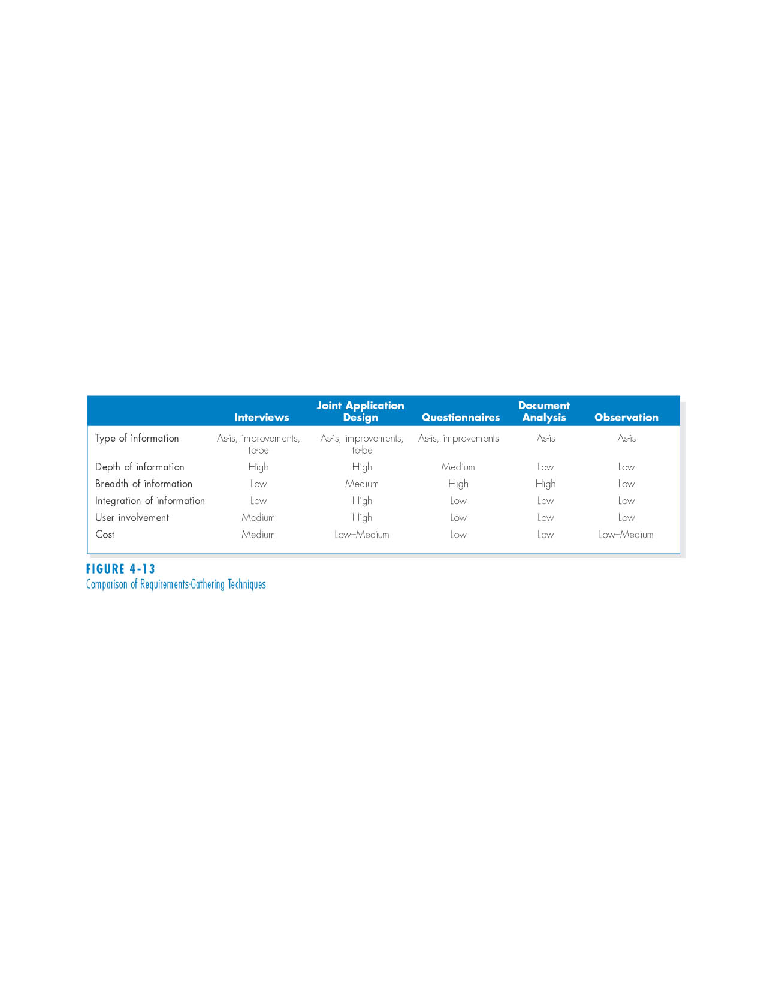
(cont’d)
Comparison of Requirements Elicitation Techniques
© Copyright 2011 John Wiley & Sons, Inc.
3-<number>

Slide 33
REQUIREMENTS ANALYSIS STRATEGIES
Problem Analysis
  Asking users to identify problems and solutions
  Improvements from problem analysis tend to be small and incremental
  This type of improvements often is very effective at improving a system’s efficiency or ease of use; however, it provides minor improvements in business value.
© Copyright 2011 John Wiley & Sons, Inc.
3-<number>

Slide 34
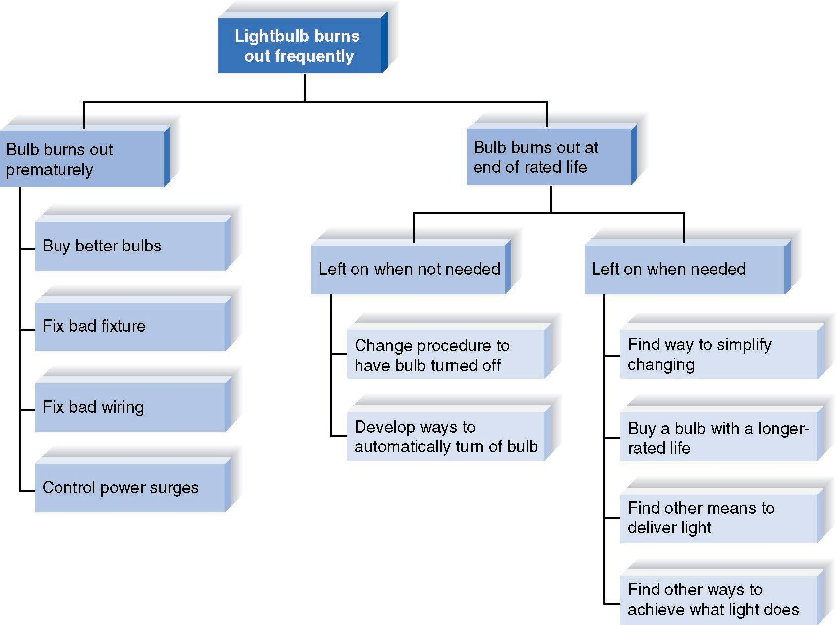
Root Cause Analysis
Root cause analysis focuses on problems first rather than solutions.
© Copyright 2011 John Wiley & Sons, Inc.
3-<number>

Slide 35
Duration Analysis
Duration analysis requires a detailed examination of amount of time it takes to perform each process in the as-is system.
Compare the total time to complete basic steps and the total time for the overall process – a significant difference indicates that the process is badly fragmented.
Potential solutions:
  Process integration
  Parallelization
© Copyright 2011 John Wiley & Sons, Inc.
3-<number>

Slide 36
Activity-Based Costing
Activity-based costing examines the cost of each major process or step in a business process.
Both direct and indirect costs are considered.
The analysts identify most costly steps and focus improvement efforts on them.
© Copyright 2011 John Wiley & Sons, Inc.
3-<number>

Slide 37
Informal Benchmarking
Benchmarking refers to studying how other organizations perform a business process.
Informal benchmarking is common for “customer-facing” processes.
The analysts visit other organizations as customers to watch how the business process is performed.
© Copyright 2011 John Wiley & Sons, Inc.
3-<number>

Slide 38
Outcome Analysis
Outcome analysis focuses on understanding fundamental outcomes that provide value to customers.
Think what the organization could enable the customer to do
© Copyright 2011 John Wiley & Sons, Inc.
3-<number>

Slide 39
Technology Analysis
Technology analysis involves two steps:
1. The analysts and managers list important and interesting technologies.
2. Then, the group identifies how each and every technology might be applied to the business and how the business would benefit.
© Copyright 2011 John Wiley & Sons, Inc.
3-<number>

Slide 40
Activity Elimination
The analysts and managers work together to identify
how the organization could eliminate each and every activity in the business process,
how the function could operate without it, and
what effects are likely to occur.
© Copyright 2011 John Wiley & Sons, Inc.
3-<number>

Slide 41
Comparing Analysis Strategies
Each of the requirement analysis strategies has its own purpose.
No one strategy is inherently better that the others.
The requirement analysis strategy should be chosen to fit the nature of the project.
© Copyright 2011 John Wiley & Sons, Inc.
3-<number>

Slide 42
SUMMARY
Analysis focuses on capturing the business requirements for the system
Requirement Determination is the part of analysis in which the project team turns the business requirements stated in the system request into a precise list of requirements.
Five Requirements Elicitation Techniques can be used to elicit business requirements.
Requirements Analysis Strategies are useful for analysts to help the business users think critically about the new system requirements.
© Copyright 2011 John Wiley & Sons, Inc.
3-<number>

Slide 43
Copyright 2011 John Wiley & Sons, Inc.
All rights reserved. Reproduction or translation of this work beyond that permitted in Section 117 of the 1976 United States Copyright Act without the express written permission of the copyright owner is unlawful. Request for further information should be addressed to the Permissions Department, John Wiley & Sons, Inc. The purchaser may make back-up copies for his/her own use only and not for redistribution or resale. The Publisher assumes no responsibility for errors, omissions, or damages, caused by the use of these programs or from the use of the information contained herein.
© Copyright 2011 John Wiley & Sons, Inc.
3-<number>

